Slide 1
Machine Learning
Ensemble Models

Slide 2
Learning Ensembles
Learn multiple alternative definitions of a concept using different training data or different learning algorithms.
Combine decisions of multiple definitions, e.g. using weighted voting.
Training Data
⋅ ⋅ ⋅ ⋅ ⋅ ⋅ ⋅ ⋅
Data1
Data2
Data m
Learner1
Learner2
⋅ ⋅ ⋅ ⋅ ⋅ ⋅ ⋅ ⋅
Learner m
⋅ ⋅ ⋅ ⋅ ⋅ ⋅ ⋅ ⋅
Model1
Model2
Model m
Model Combiner
Final Model

Slide 3
Value of Ensembles
When combing multiple independent and diverse decisions each of which is at least more accurate than random guessing, random errors cancel each other out, correct decisions are reinforced.
Human ensembles are demonstrably better
How many jelly beans in the jar?: Individual estimates vs. group average.
Who Wants to be a Millionaire: Expert friend vs. audience vote.
The key of designing ensembles is diversity and not necessarily high accuracy of the base classifiers: Members of the ensemble should vary in the examples they misclassify. Therefore, most ensemble approaches seek to promote diversity among the models they combine.
Generate a group of base-learners which when combined has higher accuracy
Different learners use different
Algorithms
Hyperparameters
Representations /Modalities/Views
Training sets
Subproblems
Diversity vs accuracy

Slide 4
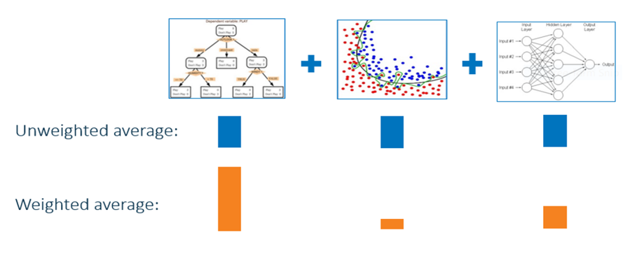
Ensembles

Slide 5
Bagging (Bootstrap Aggregation)
Employs simple way of combining predictions that belong to the same type.
Combining can be realized with voting or averaging
Each model receives equal weight
Bagging:
Sample several training sets of size n (instead of just having one training set of size n)
Build a classifier for each training set
Combine the classifier’s predictions
Bagging reduces variance by voting/ averaging, thus reducing the overall expected error
This improves performance in almost all cases if algorithm is unstable (i.e. decision trees)

Slide 6
Bagging classifiers
Classifier generation
Let n be the size of the training set.
For each of t iterations:
Sample n instances with replacement from the training set.
Apply the learning algorithm to the sample.
Store the resulting classifier.
classification
For each of the t classifiers:
Predict class of instance using classifier.
Return class that was predicted most often.

Slide 7
Boosting
Also uses voting/averaging but models are weighted according to their performance
Iterative procedure: new models are influenced by performance of previously built ones
New model is encouraged to become expert for instances classified incorrectly by earlier models
Intuitive justification: models should be experts that complement each other
There are several variants of this algorithm

Slide 8
Boosting
Strong Learner →Objective of machine learning
Take labeled data for training
Produce a classifier which can be arbitrarily accurate
Strong learners are very difficult to construct
Weak Learner
Take labeled data for training
Produce a classifier which is more accurate than random guessing
Constructing weaker Learners is relatively easy
Weak Learner: only needs to generate a hypothesis with a training accuracy greater than 0.5, i.e., < 50% error over any distribution
Question: Can a set of weak learners create a single strong learner ?
Boost weak classifiers to a strong learner
Key Insights
Instead of sampling (as in bagging) re-weight examples
Examples are given weights. At each iteration, a new classifier is learned (weak learner) and the examples are reweighted to focus the system on examples that the most recently learned classifier got wrong.
Final classification based on weighted vote of weak classifiers

Slide 9
Boosting Example
Classes +1 , -1
Original data set, D₁ Update weights, D₂
Update weights, D₃
-
-
-
- ₋
-
-
+
-
- +
-
+
+
-
+
+
-
-
+
-
-
+
+
+
+
+
+
+
+
Trained classifier
Trained classifier
Trained classifier
-
-
-
- - | + + | - | + | - | - | +
 |  |  |  |  |  | +
-
-
-
- +
-
+
-
+
-
+
+
+
+
+
+
+

Slide 10
Boosting Example
Weight each classifier and combine them:
>
.33 *
+ .57 *
+ .42 *
<
0
Combined classifier
 |  | - ₋ - | +
- - |  | + ₊ + | +
1-node decision trees “decision stumps” very simple classifiers

Slide 11









Adaptive Boosting
Each rectangle corresponds to an example, with weight proportional to its height.
Crosses correspond to misclassified examples.
Size of decision tree indicates the weight of that classifier in the final ensemble.
Using Different Data Distribution
Start with uniform weighting
During each step of learning
Increase weights of the examples which are not correctly learned by the weak learner
Decrease weights of the examples which are correctly learned by the weak learner
Idea
Focus on difficult examples which are not correctly classified in the previous steps
Weighted Voting
Construct strong classifier by weighted voting of the weak classifiers
Idea
Better weak classifier gets a larger weight
Iteratively add weak classifiers
Increase accuracy of the combined classifier through minimization of a cost function

Slide 12
Adaptive Boosting: High Level Description
C =0; /* counter*/
M = m; /* number of classifiers to generate*/
1 Set same weight for all the examples (typically each example has weight = 1);
2 While (C < M)
2.1 Increase counter C by 1.
2.2 Generate classifier (learner) h_{C} .
2.3 Increase the weight of the misclassified examples in classifier h_{C}
3 Weighted majority combination of all M classifiers (weights according to how well it performed on the training set).
Many variants depending on how to set the weights and how to combine the classifiers. AdaBoost, XGBoost → popular!!!!
If the input learning is a Weak Learner, then ADABOOST will return a hypothesis that classifies the training data perfectly for a large enough M, boosting the accuracy of the original learning algorithm on the training data.
Strong Classifier: thresholded linear combination of weak learner outputs.

Slide 13
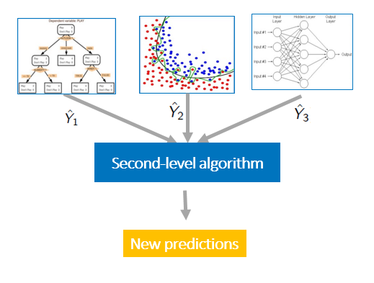
Model Stacking
Model stacking is an efficient ensemble method in which the predictions, generated by using various machine learning algorithms, are used as inputs in a second-layer learning algorithm.
This second-layer algorithm is trained to optimally combine the model predictions to form a new set of predictions

Slide 14
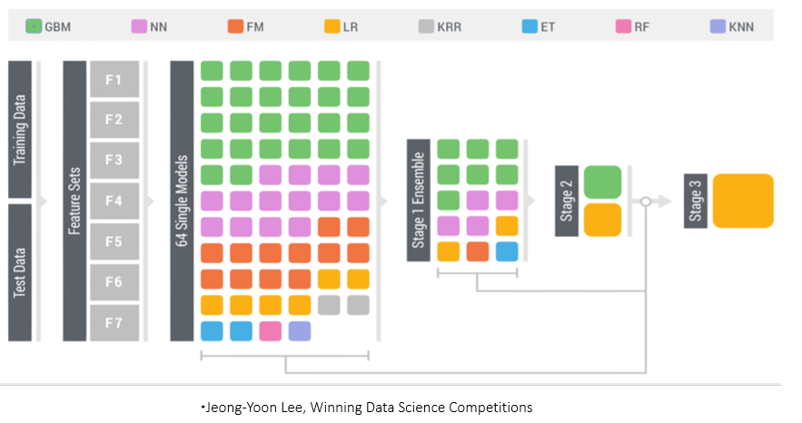
Ensembles

Slide 15
Tree-based Methods: A refresher
Here we describe tree-based methods for regression and classification.
These involve stratifying or segmenting the predictor space into a number of simple regions.
Since the set of splitting rules used to segment the predictor space can be summarized in a tree, these types of approaches are known as decision-tree methods.
Decision trees can be applied to both regression and classification problems.
We first consider regression problems, and then move on to classification.

Slide 16
Baseball salary data: how would you stratify it?
Salary is color-coded from low (blue, green) to high (yellow,red)
Years < 4.5
|
●
●
Hits < |  | 117.5
11
●  
200
●
● 
● 
●
● 
● 
●
●
●
●
●
●     
●
●  
●  
●
150
●  
●
● 
●   
●
● 
●     
● 
●
●
● 
●   
●
●
●   
● 
● 
●   
● 
Hits
●  
●  
●
●     
●
●
●
●
● 
● 
●
●
● 
●
100
● 
●
●  
●    
● 
●
●
●      
●
●
●     
● 
●
●   
●
●
●
● 
●
●
●      
●     
● 
●
●
●
●
●
●
●     
●
50
●     
●
●
●
●    
● 
●
●
●
●
●
●
● 
●
●
5.
●
0
● 
5
10
15
20
6.00
6.74
Years

Slide 17
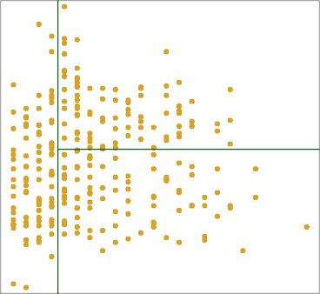
Results
Overall, the tree stratifies or segments the players into three regions of predictor space:
R₁ ={X | Years< 4.5}, R₂ ={X | Years>=4.5, Hits<117.5}, and R₃ ={X | Years>=4.5, Hits>=117.5}
In keeping with the tree analogy, the regions R₁, R₂, and R₃ are known as terminal nodes
Decision trees are typically drawn upside down, in the sense that the leaves are at the bottom of the tree.
The points along the tree where the predictor space is split are referred to as internal nodes
In the hitters tree, the two internal nodes are indicated by the text Years<4.5 and Hits<117.5.
R₃
Hits
R₁
117.5
R₂
1
4.5
24
1
Years

Slide 18

Details of the tree-building process
We divide the predictor space — that is, the set of possible values for X₁, X₂, . . . , X_{p} into J distinct and non-overlapping regions, R₁, R₂, . . . , R_{J} .
For every observation that falls into the region R_{j}, we make the same prediction, which is simply the mean of the response values for the training observations in R_{j} .
In theory, the regions could have any shape. However, we choose to divide the predictor space into high-dimensional rectangles, or boxes, for simplicity and for ease of interpretation of the resulting predictive model.
The goal is to find boxes R₁, . . . , R_{J} that minimize the RSS, given by
where yˆ_{Rj} is the mean response for the training observations within the jthbox.
Unfortunately, it is computationally infeasible to consider every possible partition of the feature space into J boxes.
For this reason, we take a top-down, greedy approach that is known as recursive binary splitting.

Slide 19
More details of the tree-building process
The approach is top-down because it begins at the top of the tree and then successively splits the predictor space; each split is indicated via two new branches further down on the tree.
It is greedy because at each step of the tree-building process, the best split is made at that particular step, rather than looking ahead and picking a split that will lead to a better tree in some future step.
We first select the predictor X_{j} and the cutpoint s such that splitting the predictor space into the regions {X|X_{j} < s} and {X|X_{j} ≥ s} leads to the greatest possible reduction in RSS.
Next, we repeat the process, looking for the best predictor and best cutpoint in order to split the data further so as to minimize the RSS within each of the resulting regions.
However, this time, instead of splitting the entire predictor space, we split one of the two previously identified regions. We now have three regions.
Again, we look to split one of these three regions further, so as to minimize the RSS. The process continues until a stopping criterion is reached; for instance, we may continue until no region contains more than five observations.
We predict the response for a given test observation using the mean of the training observations in the region to which that test observation belongs.
A five-region example of this approach is shown in the next slide.

Slide 20
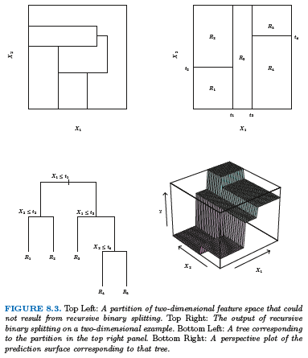

Slide 21
Pruning a tree
The process described above may produce good predictions on the training set, but is likely to overfit the data, leading to poor test set performance.
A smaller tree with fewer splits (that is, fewer regions R₁, . . . , R_{J} ) might lead to lower variance and better interpretation at the cost of a little bias.
One possible alternative to the process described above is to grow the tree only so long as the decrease in the RSS due to each split exceeds some (high) threshold.
This strategy will result in smaller trees, but is too short-sighted: a seemingly worthless split early on in the tree might be followed by a very good split — that is, a split that leads to a large reduction in RSS later on.

Slide 22

Pruning a tree— continued
A better strategy is to grow a very large tree T₀, and then
prune it back in order to obtain a subtree
Cost complexity pruning — also known as weakest link pruning — is used to do this
we consider a sequence of trees indexed by a nonnegative tuning parameter α. For each value of α there corresponds a subtree T ⊂ T₀ such that
is as small as possible. Here |T | indicates the number of terminal nodes of the tree T , R_{m} is the rectangle (i.e. the subset of predictor space) corresponding to the mth terminal node, and yˆ_{Rm} is the mean of the training observations in R_{m}.
The tuning parameter α controls a trade-off between the subtree’s complexity and its fit to the training data.
We select an optimal value αˆ using cross-validation.
We then return to the full data set and obtain the subtree corresponding to αˆ.

Slide 23
Summary: tree algorithm
Use recursive binary splitting to grow a large tree on the training data, stopping only when each terminal node has fewer than some minimum number of observations.
Apply cost complexity pruning to the large tree in order to obtain a sequence of best subtrees, as a function of α.
Use K-fold cross-validation to choose α. For each
k = 1, . . . , K:
3.1Repeat Steps 1 and 2 on the ^{K−1} th fraction of the training
K
data, excluding the kth fold.
3.2Evaluate the mean squared prediction error on the data in the left-out kth fold, as a function of α.
Average the results, and pick α to minimize the average error.
4.Return the subtree from Step 2 that corresponds to the chosen value of α.

Slide 24
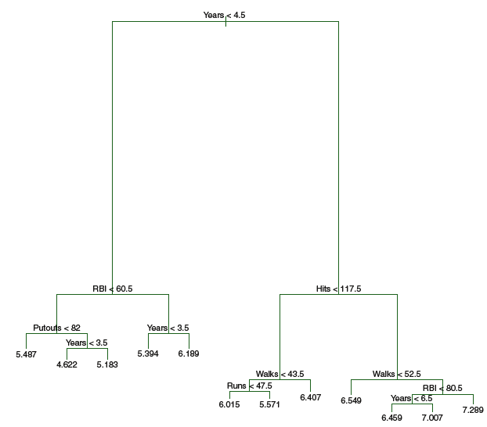
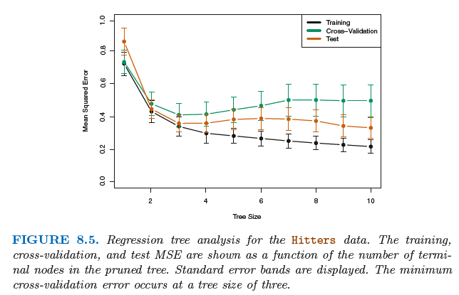
Baseball example continued
First, we randomly divided the data set in half, yielding 132 observations in the training set and 131 observations in the test set.
We then built a large regression tree on the training data and varied α in in order to create subtrees with different numbers of terminal nodes.
Finally, we performed six-fold cross-validation in order to estimate the cross-validated MSE of the trees as a function of α.

Slide 25

Classification Trees
Very similar to a regression tree, except that it is used to predict a qualitative response rather than a quantitative one.
For a classification tree, we predict that each observation belongs to the most commonly occurring class of training observations in the region to which it belongs.
Just as in the regression setting, we use recursive binary splitting to grow a classification tree.
In the classification setting, RSS cannot be used as a criterion for making the binary splits
A natural alternative to RSS is the classification error rate. this is simply the fraction of the training observations in that region that do not belong to the most common class:
Here pˆ_{mk} represents the proportion of training observations in the mth region that are from the kth class.
However classification error is not sufficiently sensitive for tree-growing, and in practice two other measures are preferable.

Slide 26


Gini index and Deviance
The Gini index is defined by
a measure of total variance across the K classes. The Gini index takes on a small value if all of the pˆ_{mk}’s are close to zero or one.
For this reason the Gini index is referred to as a measure of node purity — a small value indicates that a node contains predominantly observations from a single class
An alternative to the Gini index is cross-entropy, given by
It turns out that the Gini index and the cross-entropy are very similar numerically.

Slide 27
Trees Versus Linear Models
2
−2 −1 0 1 2 −2 −1 0 1 2
0 1
X2
X2
−1
−2
−2
−1
0
1
2
−2
−1
0
1
2
X1
X1
2
1
X2
−2 −1 0
X2
−2
−1
0
1
2
−2
−1
0
1
2
X1 X1
Top Row: True linear boundary; Bottom row: true non-linear boundary.
Left column: linear model; Right column: tree-based model

Slide 28
Advantages and Disadvantages of Trees
Trees are very easy to explain to people. In fact, they are even easier to explain than linear regression!
Some people believe that decision trees more closely mirror human decision-making than do the regression and classification approaches seen in previous chapters.
Trees can be displayed graphically, and are easily interpreted even by a non-expert (especially if they are small).
Trees can easily handle qualitative predictors without the need to create dummy variables.
Unfortunately, trees generally do not have the same level of predictive accuracy as some of the other regression and classification approaches.
Additionally, trees can be very non-robust. In other words, a small change in the data can cause a large change in the final estimated tree.
However, by aggregating many decision trees, the predictive performance of trees can be substantially improved. We introduce these concepts next.

Slide 29

Bagging
Bootstrap aggregation, or bagging, is a general-purpose procedure for reducing the variance of a statistical learning method; It is particularly useful and frequently used in the context of decision trees.
Recall that given a set of n independent observations Z₁, . . . , Z_{n}, each with variance σ², the variance of the mean Z¯ of the observations is given by σ²/n.
In other words, averaging a set of observations reduces variance. Of course, this is not practical because we generally do not have access to multiple training sets.
Instead, we can bootstrap, by taking repeated samples from the (single) training data set.
In this approach we generate B different bootstrapped training data sets. We then train our method on the b^{th} bootstrapped training set in order to get fˆ∗b(x), the prediction at a point x. We then average all the predictions to obtain
This is called bagging.

Slide 30
Bagging classification trees
For classification trees: for each test observation, we record the class predicted by each of the B trees, and take a majority vote: the overall prediction is the most commonly occurring class among the B predictions.
Out-of-Bag Error Estimation
It turns out that there is a very straightforward way to estimate the test error of a bagged model.
Recall that the key to bagging is that trees are repeatedly fit to bootstrapped subsets of the observations. One can show that on average, each bagged tree makes use of around two-thirds of the observations.
The remaining one-third of the observations not used to fit a given bagged tree are referred to as the out-of-bag (OOB) observations.
We can predict the response for the ith observation using each of the trees in which that observation was OOB. This will yield around B/3 predictions for the ith observation, which we average.
This estimate is essentially the Leave One Out (LOO) cross-validation error for bagging, if B is large.

Slide 31
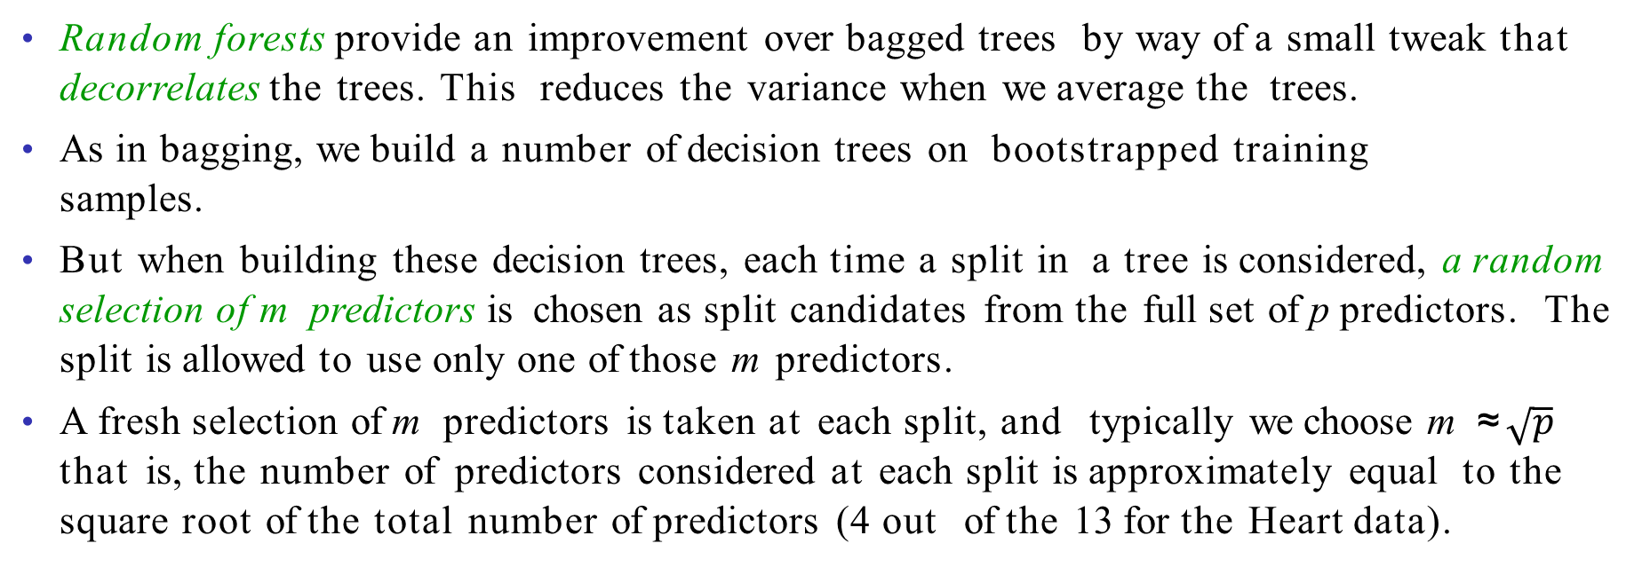
Random Forests
Random forests provide an improvement over bagged trees by way of a small tweak that decorrelates the trees. This reduces the variance when we average the trees.
As in bagging, we build a number of decision trees on bootstrapped training samples.
But when building these decision trees, each time a split in a tree is considered, a random selection of m predictors is chosen as split candidates from the full set of p predictors. The split is allowed to use only one of those m predictors.
A fresh selection of m predictors is taken at each split, and typically we choose m ≈ $\sqrt{p}$ that is, the number of predictors considered at each split is approximately equal to the square root of the total number of predictors (4 out of the 13 for the Heart data).

Slide 32
Example: gene expression data
We applied random forests to a high-dimensional biological data set consisting of expression measurements of 4,718 genes measured on tissue samples from 349 patients.
There are around 20,000 genes in humans, and individual genes have different levels of activity, or expression, in particular cells, tissues, and biological conditions.
Each of the patient samples has a qualitative label with 15 different levels: either normal or one of 14 different types of cancer.
We use random forests to predict cancer type based on the 500 genes that have the largest variance in the training set.
We randomly divided the observations into a training and a test set, and applied random forests to the training set for three different values of the number of splitting variables m.

Slide 33
Results: gene expression data
m=p
m=p/2
m= p
Results from random forests for the fifteen-class gene expression data set with p = 500 predictors.
The test error is displayed as a function of the number of trees. Each colored line corresponds to a different value of m, the number of predictors available for splitting at each interior tree node.
Random forests (m < p) lead to a slight improvement over bagging (m = p). A single classification tree has an error rate of 45.7%.
0.5
Test Classification Error
0.4
0.3
0.2
0
100
200 300
Number of Trees
400
500

Slide 34
Boosting
Like bagging, boosting is a general approach that can be applied to many statistical learning methods for regression or classification. We only discuss boosting for decision trees.
Recall that bagging involves creating multiple copies of the original training data set using the bootstrap, fitting a separate decision tree to each copy, and then combining all of the trees in order to create a single predictive model.
Notably, each tree is built on a bootstrap data set, independent of the other trees.
Boosting works in a similar way, except that the trees are grown sequentially: each tree is grown using information from previously grown trees.

Slide 35
What is the idea behind this procedure?
Unlike fitting a single large decision tree to the data, which amounts to fitting the data hard and potentially overfitting, the boosting approach instead learns slowly.
Given the current model, we fit a decision tree to the residuals from the model. We then add this new decision tree into the fitted function in order to update the residuals.
Each of these trees can be rather small, with just a few terminal nodes, determined by the parameter d in the algorithm.
By fitting small trees to the residuals, we slowly improve f^{ˆ} in areas where it does not perform well. The shrinkage parameter λ slows the process down even further, allowing more and different shaped trees to attack the residuals.

Slide 36
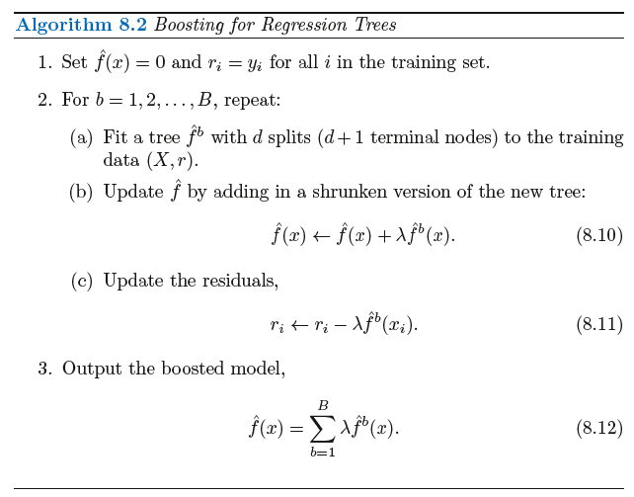
Boosting algorithm for regression trees

Slide 37
Gene expression data continued
0.25
Results from performing boosting and random forests on the fifteen-class gene expression data set in order to predict cancer versus normal.
The test error is displayed as a function of the number of trees. For the two boosted models, λ = 0.01. Depth-1 trees slightly outperform depth-2 trees, and both outperform the random forest, although the standard errors are around 0.02, making none of these differences significant.
The test error rate for a single tree is 24%.
Boosting: depth=1 Boosting: depth=2 RandomForest: m= p
Test Classification Error
0.20
0.15
0.10
0.05
0
1000
2000 3000
Number of Trees
4000
5000

Slide 38
Tuning parameters for boosting
The number of trees B. Unlike bagging and random forests, boosting can overfit if B is too large, although this overfitting tends to occur slowly if at all. We use cross-validation to select B.
The shrinkage parameter λ, a small positive number. This controls the rate at which boosting learns. Typical values are 0.01 or 0.001, and the right choice can depend on the problem. Very small λ can require using a very large value of B in order to achieve good performance.
The number of splits d in each tree, which controls the complexity of the boosted ensemble. Often d = 1 works well, in which case each tree is a stump, consisting of a single split and resulting in an additive model. More generally d is the interaction depth, and controls the interaction order of the boosted model, since d splits can involve at most d variables.

Slide 39
Random Forests vs Boosted Trees
The “geometry” of the methods is very different
Random forest use 10’s of deep, large trees:
Depth 20-30
…
100k’s of nodes
Bias reduction
through depth
10’s of trees
Variance reduction through the ensemble aggregate

Slide 40
Random Forests vs Boosted Trees
Boosted decision trees use 1000’s of shallow, small trees:
…
Depth 10-15
1k’s of nodes
1000’s of trees
Bias reduction through boosting – variance already low

Slide 41
Random Forests vs Boosted Trees
RF training is parallel, can be very fast
Evaluation of trees (runtime) also much faster for RFs
Depth 20-30
…
100k’s of nodes
10’s of trees
…
Depth 10-15
1k’s of nodes
1000’s of trees

Slide 42
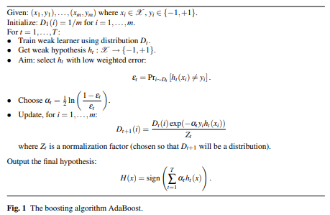
AdaBoost

Slide 43
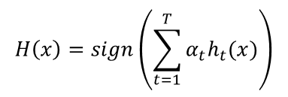

AdaBoost
Let’s look first at the equation for the final classifier
The final classifier consists of ‘T’ weak classifiers. h_{t}(x) is the output of weak classifier ‘t’. α_{t} is the weight applied to classifier ‘t’ as determined by AdaBoost. So the final output is just a linear combination of all of the weak classifiers, and then we make our final decision simply by looking at the sign of this sum.
The classifiers are trained one at a time. After each classifier is trained, we update the probabilities of each of the training examples appearing in the training set for the next classifier.
The first classifier (t = 1) is trained with equal probability given to all training examples. After it’s trained, we compute the output weight (alpha) for that classifier.
The output weight, α_{t} is based on the classifier’s error rate, ε_{t}. ε_{t} is just the number of misclassifications over the training set divided by the training set size

Slide 44
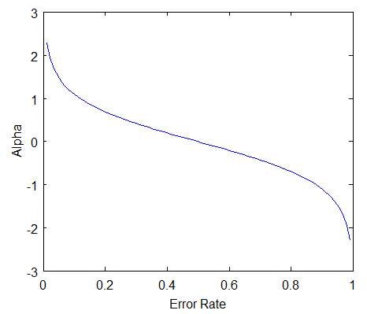
AdaBoost
There are three bits of intuition to take from this graph:
The classifier weight grows exponentially as the error approaches 0. Better classifiers are given exponentially more weight.
The classifier weight is zero if the error rate is 0.5. A classifier with 50% accuracy is no better than random guessing, so we ignore it.
The classifier weight grows exponentially negative as the error approaches 1. We give a negative weight to classifiers with worse than 50% accuracy. “Whatever that classifier says, do the opposite!”.

Slide 45

AdaBoost
After computing the alpha for the first classifier, we update the training example weights using the following formula.
The variable D_{t} is a vector of weights, with one weight for each training example in the training set. ‘i’ is the training example number. This equation shows you how to update the weight for the i^{th} training example.
The algorithm describes D_{t} as a distribution. This just means that each weight D(i) represents the probability that training example i will be selected as part of the training set.
To make it a distribution, all of these probabilities should add up to 1. To ensure this, we normalize the weights by dividing each of them by the sum of all the weights, Z_{t}.
This vector is updated for each new weak classifier that’s trained. D_{t} refers to the weight vector used when training classifier ‘t’.
This equation needs to be evaluated for each of the training samples ‘i’ (x_{i}, y_{i}). Each weight from the previous training round is going to be scaled up or down by this exponential term
The function exp(x) will return a fraction for negative values of x, and a value greater than one for positive values of x. So the weight for training sample i will be either increased or decreased depending on the final sign of the term “-alpha * y * h(x)”.
y_{i} is the correct output for training example ‘i’, and h_{t}(x_i) is the predicted output by classifier t on this training example. If the predicted and actual output agree, y * h(x) will always be +1 (either 1 * 1 or -1 * -1). If they disagree, y * h(x) will be negative.
Ultimately, misclassifications by a classifier with a positive alpha will cause this training example to be given a larger weight. And vice versa.

Slide 46
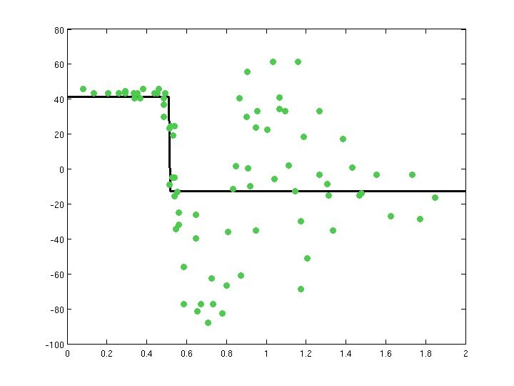
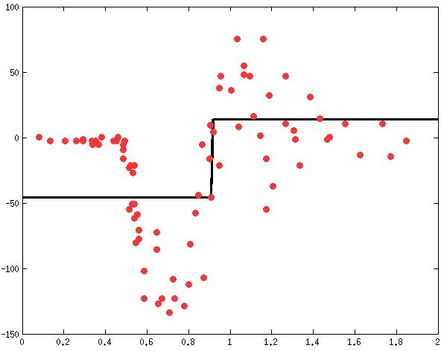
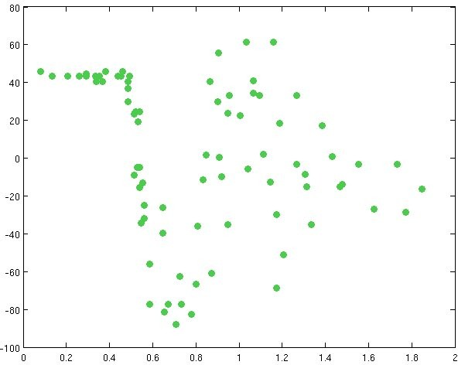
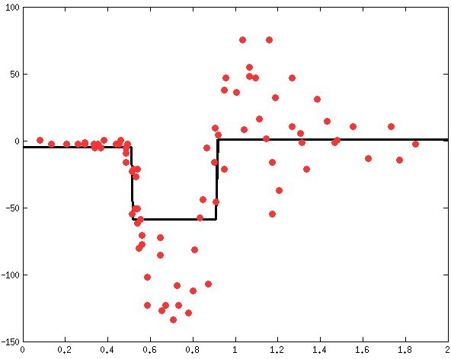
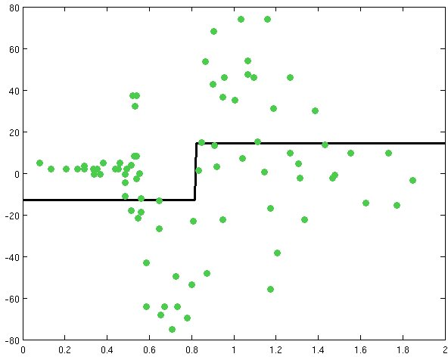
Gradient Boosting
Learn a simple predictor…
Then try to correct its errors
Learn a regression predictor
Compute the error residual
Learn to predict the residual
Combining gives a better predictor…
Can try to correct its errors also, & repeat

Slide 47


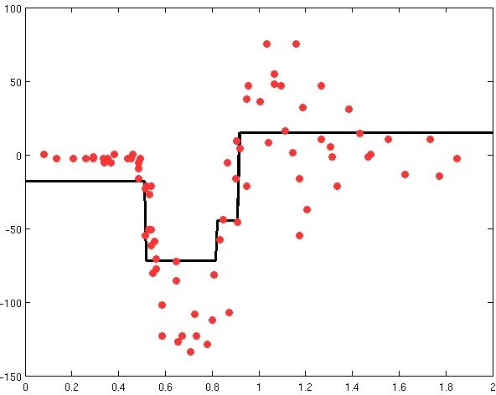
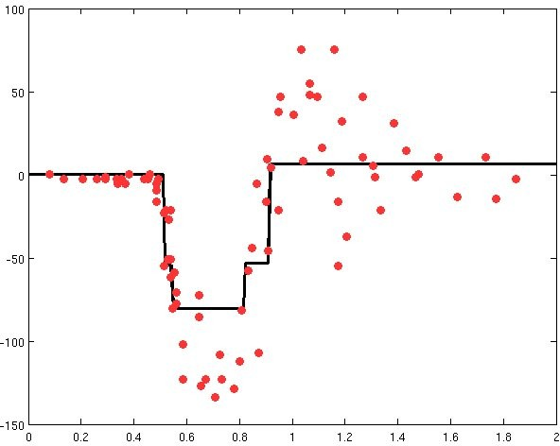
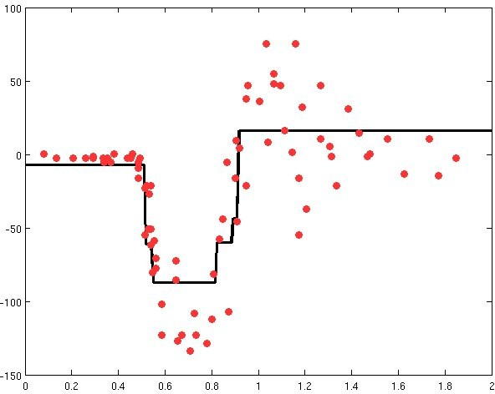
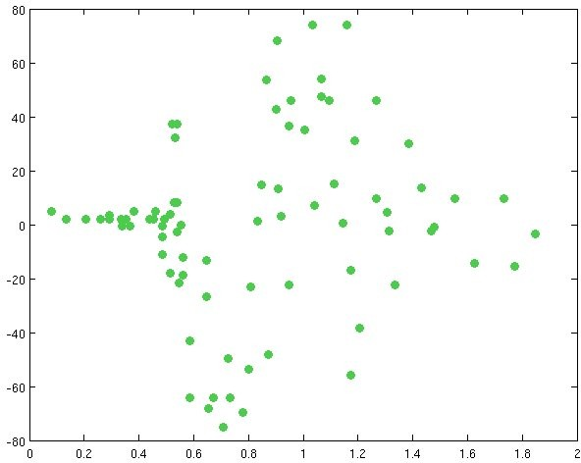
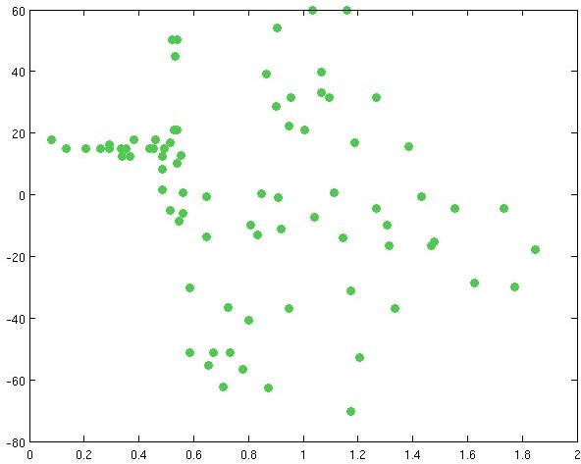
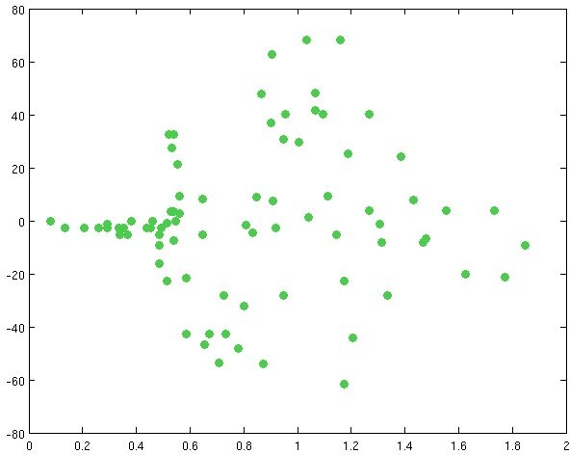
Gradient Boosting
Learn sequence of predictors
Sum of predictions is increasingly accurate
Predictive function is increasingly complex
Data & prediction function
Error residual
…

Slide 48
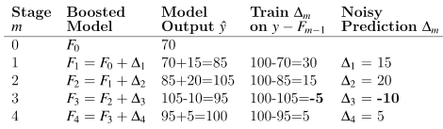
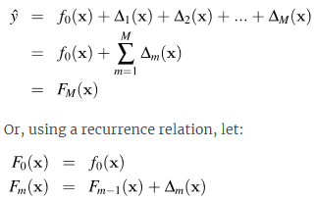
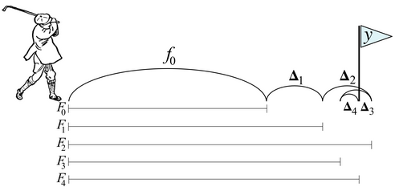

Gradient Boosting
Add a learning rate eta to get
The primary value of the learning rate, or “shrinkage” as some call it, is to reduce overfitting of the overall model.

Slide 49
Gradient Descent
Imagine we are on top of a hill and want to get down. The way to get down is to keep going downhill until you reach the bottom, taking steps to the left, right, forward, backward or at an angle in order to minimize the “elevation function.”
The idea is to take big steps along an axis when the slope is steep but small steps when the slope is shallow. As we approach the bottom of the mountain, we should take really small steps to avoid overshooting and going back up the other side.
We're looking for a direction vector with components for each of the x and y axes that takes us downhill, according to some elevation function.
Updating the current position with a direction vector containing magnitude information, proportional to the slope, automatically takes smaller steps as the slope flattens out.

Slide 50

Gradient Descent
Mathematically, we compute the direction vector from the partial derivatives of f(x,y) with respect to the x and y dimensions. A vector of the partial derivatives of f(x,y) is called a gradient and is written:
The gradient is actually the opposite or negative of the direction vector we want because the slope always points in the uphill direction.
Consequently, to move downhill, not uphill, we update the current position by adding in the negative of the gradient.
Let's generalize our position update equation to handle more than two dimensions. Rather than x and y, let's use x (in bold) to represent all of the function parameters

Slide 51

Gradient Descent
The next position of , at time step t, is given by
In practice, we need to restrict the size of the steps we take from x_{t} to x_{t-1} by shrinking the direction vector using a learning rate, η, whose value is less than 1
This brings us to the position update equation found in most literature:

Slide 52
Gradient Descent
The key takeaways from this gradient descent discussion are:
Minimizing a function, f(x), means finding the position where f(x) has minimal value.
The procedure is to pick some initial (random or best guess) position for and then gradually nudge x in the downhill direction, which is the direction where the f(x) value is smaller.
The gradient of f(x) gives us the direction of uphill and so we negate the gradient to get the downhill direction vector.
We update position x_{t} to x_{t-1} , where the function is lower, by adding the direction vector to x, scaled by the learning rate, η .

Slide 53
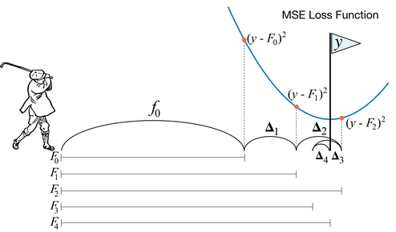

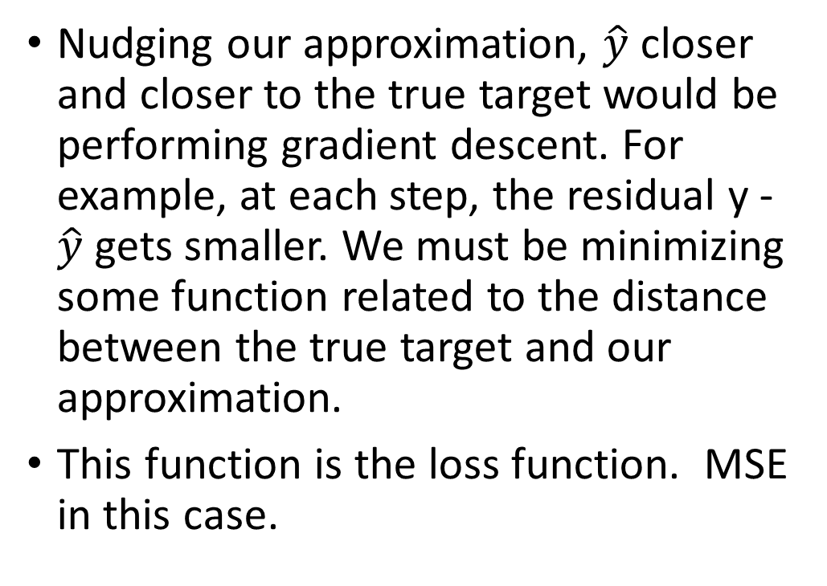
Boosting is gradient descent in prediction space
Nudging our approximation, $\hat{y}$ closer and closer to the true target would be performing gradient descent. For example, at each step, the residual y - $\hat{y}$ gets smaller. We must be minimizing some function related to the distance between the true target and our approximation.
This function is the loss function. MSE in this case.

Slide 54
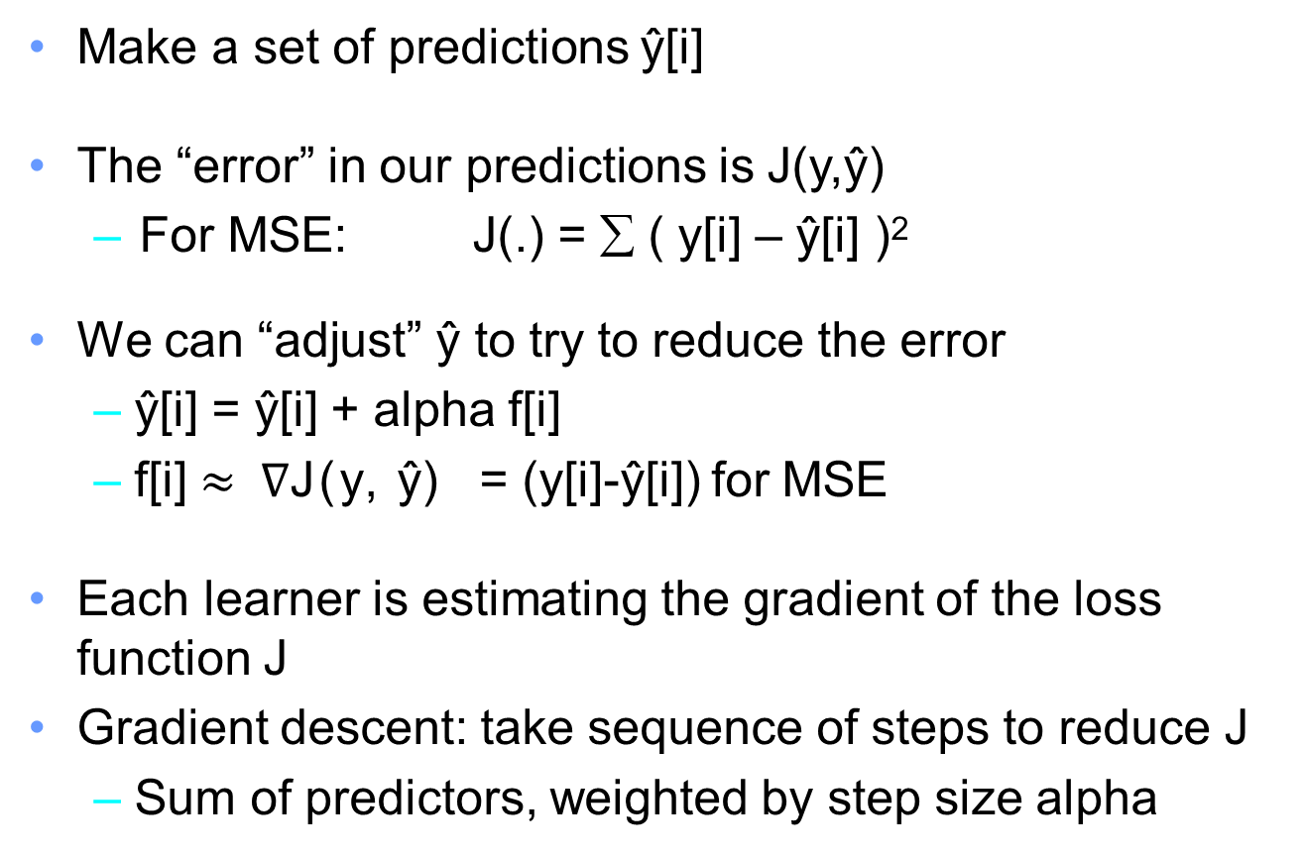
Gradient boosting
Make a set of predictions ŷ[i]
The “error” in our predictions is J(y,ŷ)
– For MSE: J(.) = ∑ ( y[i] – ŷ[i] )²
We can “adjust” ŷ to try to reduce the error
ŷ[i] = ŷ[i] + alpha f[i]
f[i] $≈ ∇$J(y, ŷ) = (y[i]-ŷ[i]) for MSE
Each learner is estimating the gradient of the loss function J
Gradient descent: take sequence of steps to reduce J
Sum of predictors, weighted by step size alpha

Slide 55
Popular Gradient Boosting Algorithms
XGBoost (Extreme Gradient Boosting)
LightGBM (Microsoft)

Slide 56
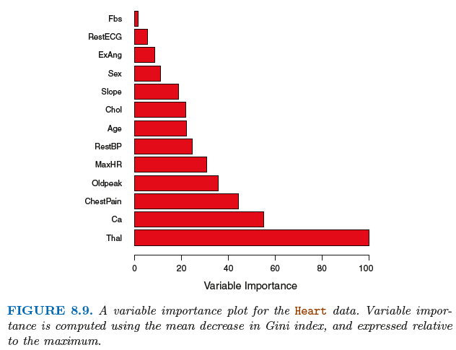
Variable importance measure
For bagged/RF regression trees, we record the total amount that the RSS is decreased due to splits over a given predictor, averaged over all B trees. A large value indicates an important predictor.
Similarly, for bagged/RF classification trees, we add up the total amount that the Gini index is decreased by splits over a given predictor, averaged over all B trees.
Variable importance plot for the Heart data

Slide 57
Summary
Decision trees are simple and interpretable models for regression and classification
However they are often not competitive with other methods in terms of prediction accuracy
Bagging, random forests and boosting are good methods for improving the prediction accuracy of trees. They work by growing many trees on the training data and then combining the predictions of the resulting ensemble of trees.
The latter two methods— random forests and boosting— are among the state-of-the-art methods for supervised learning. However their results can be difficult to interpret.

Slide 58
Reading
Ch 8 in Introduction to Statistical Learning

Slide 59
Appendix: XGBoost (Extreme Gradient Boosting) parameters
Consistently used to win machine learning competitions on Kaggle
Booster[default=gbtree]
Sets the booster type (gbtree, gblinear or dart) to use. For classification problems, you can use gbtree, dart. For regression, you can use any.
Parameters for Tree Booster
nrounds[default=100]
It controls the maximum number of iterations. For classification, it is similar to the number of trees to grow. Should be tuned using CV
eta[default=0.3][range: (0,1)]
It controls the learning rate, i.e., the rate at which our model learns patterns in data. After every round, it shrinks the feature weights to reach the best optimum. Lower eta leads to slower computation. It must be supported by increase in nrounds. Typically, it lies between 0.01 - 0.3
gamma[default=0][range: (0,Inf)]
It controls regularization (or prevents overfitting). The optimal value of gamma depends on the data set and other parameter values. Higher the value, higher the regularization. Regularization means penalizing large coefficients which don't improve the model's performance. default = 0 means no regularization.
Tune trick: Start with 0 and check CV error rate. If you see train error >>> test error, bring gamma into action. Higher the gamma, lower the difference in train and test CV. If you have no clue what value to use, use gamma=5 and see the performance. Remember that gamma brings improvement when you want to use shallow (low max_depth) trees.

Slide 60
Parameters continued…
max_depth[default=6][range: (0,Inf)]
It controls the depth of the tree. Larger the depth, more complex the model; higher chances of overfitting. There is no standard value for max_depth. Larger data sets require deep trees to learn the rules from data. Should be tuned using CV
min_child_weight[default=1][range:(0,Inf)]
In regression, it refers to the minimum number of instances required in a child node. In classification, if the leaf node has a minimum sum of instance weight (calculated by second order partial derivative) lower than min_child_weight, the tree splitting stops. In simple words, it blocks the potential feature interactions to prevent overfitting. Should be tuned using CV.
subsample[default=1][range: (0,1)]
It controls the number of samples (observations) supplied to a tree. Typically, its values lie between (0.5-0.8)
colsample_bytree[default=1][range: (0,1)]
It control the number of features (variables) supplied to a tree Typically, its values lie between (0.5,0.9)
lambda[default=0]
It controls L2 regularization (equivalent to Ridge regression) on weights. It is used to avoid overfitting.
alpha[default=1]
It controls L1 regularization (equivalent to Lasso regression) on weights. In addition to shrinkage, enabling alpha also results in feature selection. Hence, it's more useful on high dimensional data sets.

Slide 61
Parameters continued…
Parameters for Linear Booster
nrounds[default=100]
It controls the maximum number of iterations (steps) required for gradient descent to converge. Should be tuned using CV
lambda[default=0]
It enables Ridge Regression. Same as above
alpha[default=1]
It enables Lasso Regression. Same as above

Slide 62
Parameters continued…
Learning Task Parameters
These parameters specify methods for the loss function and model evaluation
Objective[default=reg:linear]
reg:linear - for linear regression
binary:logistic - logistic regression for binary classification. It returns class probabilities
multi:softmax - multiclassification using softmax objective. It returns predicted class labels. It requires setting num_class parameter denoting number of unique prediction classes.
multi:softprob - multiclassification using softmax objective. It returns predicted class probabilities.
eval_metric [no default, depends on objective selected]
These metrics are used to evaluate a model's accuracy on validation data. For regression, default metric is RMSE. For classification, default metric is error.
Available error functions are as follows:
mae - Mean Absolute Error (used in regression)
Logloss - Negative loglikelihood (used in classification)
AUC - Area under curve (used in classification)
RMSE - Root mean square error (used in regression)
error - Binary classification error rate [#wrong cases/#all cases]
mlogloss - multiclass logloss (used in classification)

Slide 63
Practice / HW
Use the Carseats data set in ISLR package
(a) Split the data set into a training set and a test set.
(b) Fit a regression tree to the training set by selecting an appropriate target variable to predict. Plot the tree, and interpret the results. What test MSE do you obtain?
(c) Use cross-validation in order to determine the optimal level of tree complexity.
(d) Use the bagging approach to do the prediction. What test MSE do you obtain? Which variables are most important? Plot the variable importance.
(e) Use random forest to do the prediction. What test MSE do you obtain? Which variables are most important. Plot the variable importance. Try various values of m, the number of variables considered at each split and describe the effect of m on the error rate.

Slide 64
Practice / HW
We now use boosting to predict Salary in the Hitters data set in the ISLR package.
(a) Remove the observations for whom the salary information is unknown, and then log-transform the salaries.
(b) Create a training set consisting of 65% of the observations, and a test set consisting of the remaining observations.
(c) Perform boosting using XGBoost on the training set with 1,000 trees for a range of values of the shrinkage parameter λ. Produce a plot with different shrinkage values on the x-axis and the corresponding training set MSE on the y-axis.
(d) Compare the test MSE of boosting to the test MSE that results from applying an linear regression approach.
(e) Which variables appear to be the most important predictors in the boosted model?
(f) Now apply bagging to the training set. What is the test set MSE for this approach?

Slide 65
Practice / HW
This question uses the Caravan data set in the ISLR package.
(a) Create a training set consisting of 75% of the observations, and a test set consisting of the remaining observations.
(b) Fit a boosting model to the training set with Purchase as the response and the other variables as predictors. Use 1,000 trees, and a shrinkage value of 0.01. Which predictors appear to be the most important?
(c) Use the boosting model to predict the response on the test data. Form a confusion matrix. What fraction of the people predicted to make a purchase do in fact make one? How does this compare with the results obtained from applying logistic regression to this data set?
(d) Try a stacking ensemble with at least two different models. What is the accuracy you get?

